Slide 1
Databases Design. Introduction to SQL LECTURE 5 SQL Data Definition Language
IITU, ALMATY, 2020

Slide 2
Review of last lecture
Normalization and Normal Forms
3NF relation is considered a «good» database design
Improvement of a database design

Slide 3
Database Design stages
Subject Area Analysis
Conceptual Design
Logical Design
Physical Design

Slide 4
SQL
SQL (Structured Query Language) is a special-purpose programming language designed for managing data held in a relational database management system (RDBMS).
Based upon relational algebra, SQL includes a data definition language (DDL) and a data manipulation language (DML).

Slide 5
SQL DDL
Data Definition Language (DDL) defines constructs that structure the data in the database.
DDL statements:
CREATE DB
CREATE TABLE
ALTER TABLE
DROP TABLE
Note: the dialect of SQL supported by PostgreSQL will be used here.

Slide 6
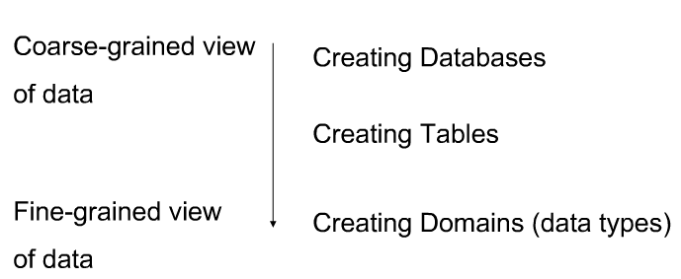
Top-Down view of SQL DDL
At the ‘top’ a database is created
Further down the hierarchy, a set of tables are created
At the bottom of the hierarchy data types are created

Slide 7
Creating a Database
PostgreSQL has the CREATEDB command that creates the database.
The create schema command takes two arguments
database name
owner of the database

Slide 8
Creating a Table
The CREATE TABLE statement allows to define
name of the table
name of each column
domain of each column
constraints on the columns (keys and other constraints)

Slide 9
Creating a Table
Syntax:
CREATE TABLE table_name (
column1name column1domain,
column2name column2domain,…,
columnNname columnNdomain,
PRIMARY KEY (pkcolumn(s)),
FOREIGN KEY (column) REFERENCES table(column) );

Slide 10
CREATE TABLE: example
CREATE TABLE Groups(
group_id int,
group_name varchar(15),
PRIMARY KEY (group_id));
or
CREATE TABLE Groups(
group_id int PRIMARY KEY ,
group_name varchar(15));

Slide 11
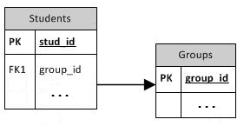
CREATE TABLE: example with FK
CREATE TABLE Groups(
group_id int,
group_name varchar(15),
PRIMARY KEY (group_id));
CREATE TABLE Students(
stud_id int,
first_name varchar(20),
last_name varchar(20),
group_id int,
PRIMARY KEY (stud_id),
FOREIGN KEY (group_id) REFERENCES Groups(group_id));

Slide 12
CREATE TABLE: example with FK
CREATE TABLE Students(
stud_id int PRIMARY KEY,
first_name varchar(20),
last_name varchar(20),
group_id int,
FOREIGN KEY (group_id) REFERENCES Groups(group_id));
or
CREATE TABLE Students(
stud_id int PRIMARY KEY,
first_name varchar(20),
last_name varchar(20),
group_id int REFERENCES Groups(group_id));

Slide 13
Defining Constraints
In addition to PK and FK constraints the following types of constraints can also be added:
CHECK
NOT NULL
UNIQUE

Slide 14
CHECK
Check constraints tell the DBMS the acceptable values for a column
We can build this constraint using the CHECK keyword in a CREATE TABLE statement.

Slide 15
CHECK example
Consider the bank account example. One integrity constrain could be that balances must be positive.
CREATE TABLE account(
id integer,
balance float CHECK (balance>0),
PRIMARY KEY (id));

Slide 16
NOT NULL
NOT NULL constraints ensures values exist in all rows for a given column.
Suppose we define balance to be NOT NULL in the Account table.
Anytime we insert an Account record, a balance must be defined. Otherwise, an error is thrown.
PKs have an implicit NOT NULL constraint.

Slide 17
NOT NULL example
Query the ACCOUNT table such that balances have a not-null constraint:
CREATE TABLE account (
id integer,
balance float NOT NULL,
PRIMARY KEY (id));

Slide 18
NOT NULL with CHECK
Query the ACCOUNT table such that balances have a not-null constraint:
CREATE TABLE account (
id integer,
balance float NOT NULL CHECK (balance>0),
PRIMARY KEY (id));

Slide 19
UNIQUE
Unique constraints ensure that values in columns are unique.
Unique allows to model alternate key (secondary key).
One or more columns may be defined as unique – so the combination of two columns may be unique, but the two columns themselves need not be unique.

Slide 20
UNIQUE example
If the CUSTOMER table had unique names – then Name is an alternate key.
We can create this CUSTOMER table as
CREATE TABLE Customer (
id integer,
name varchar(6),
PRIMARY KEY (id),
UNIQUE (name));

Slide 21
UNIQUE example
CREATE TABLE Customer (
id int,
name varchar(6),
PRIMARY KEY (id),
UNIQUE (name));
or
CREATE TABLE Customer (
id int PRIMARY KEY,
name varchar(6) UNIQUE);

Slide 22
Data types
SQL allows columns to be defined as one of five main classes of data:
Numeric
Character strings
Bit strings
Temporal Data
Boolean Data

Slide 23
Numeric Data
Exact numbers may be INTEGER (or INT), SMALLINT, BIGINT
Like the C programming language’s short data type, SMALLINT ranges between -32768 to 32767 inclusive.
INTEGER ranges between -2,147,483,648 and 2,147,483,647 inclusive.
BIGINT ranges between -9,223,372,036,854,775,808 and 9,223,372,036,854,775,807 inclusive.

Slide 24
Numeric Data
Approximate numbers are numbers that cannot be represented exactly, such as real numbers (pi).
We represent such numbers as floating-point values of various precisions (numbers of decimal places).

Slide 25
Character Strings
Character strings are sequences of printable characters
All character strings in SQL are started and ended using single quotes. For example, ‘string’ is a valid SQL string.
Character strings come in two flavors:
Fixed-length strings
Variable-length strings

Slide 26
Character Strings
Fixed-length character strings are defined to be of a given length, say 10 characters.
All values in the column of this type have 10 characters.
If any rows have less than 10 characters, they are padded with spaces to fill up the space.
Columns of this type are defined as char(n) where n is the length of the string. So, a ten-character string is defined as char(10).
The default length is 1, so char defines a 1-character column.

Slide 27
Character Strings
Variable-length character strings have a maximum length, like fixed-length character strings, but, unlike fixed-length strings, variable-length strings that are shorter than the maximum length are not padded with spaces.
Variable-length strings are known as varchars. We define a variable length string with a maximum of 10 characters as varchar(10).

Slide 28
Temporal Data
SQL provides support for storing date and time data.
All SQL implementations support the DATE data type.
PostgreSQL supports timestamp, interval, date, time and time with time zone types.

Slide 29
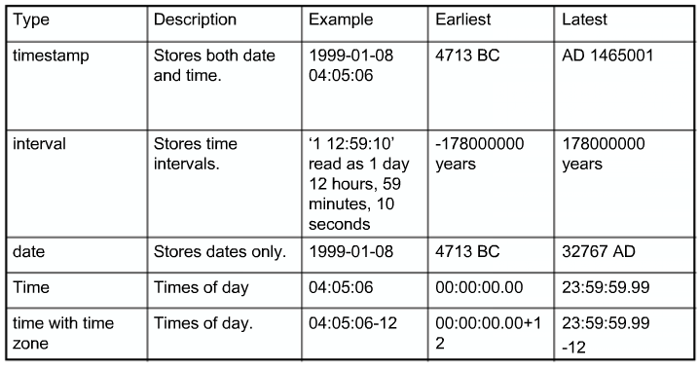
Temporal Data

Slide 30
Boolean Data Types
PostgreSQL (and most other dialects of SQL) support the boolean data type.
Valid forms of true are:
TRUE, ‘t’, ‘true’, ‘y’, ‘yes’, ‘1’
Valid forms of false are:
FALSE, ‘f’, ‘false’, ‘n’, ‘no’, ‘0’

Slide 31
Altering a Table
When you create a table and you realize that you made a mistake, or the requirements of the application change, you can drop the table and create it again. But this is not a convenient option if the table is already filled with data, or if the table is referenced by other database objects (for instance a foreign key constraint). Therefore PostgreSQL provides a family of commands to make modifications to existing tables.
ALTER TABLE command is used to modify a structure of an existing table.

Slide 32
Altering a Table
The syntax is
ALTER TABLE table_name …;
Possible modifications:
Add / remove columns
Add / remove constraints
Change column data types
Rename columns / tables
Etc.

Slide 33
Add column
Suppose we wanted to add a column to bank database’s account table that stored the data the account was opened. The original account table was created as
CREATE TABLE account (
id integer,
balance float,
PRIMARY KEY (id));

Slide 34
Add column
The syntax is
ALTER TABLE table_name ADD COLUMN column_name datatype;
So, to add the opening date of an account, we write the following query:
ALTER TABLE account ADD COLUMN opendate date;

Slide 35
Add column with constraints
The syntax is
ALTER TABLE table_name ADD COLUMN column_name datatype constraint;
So, to add the opening date of an account, we write the following query:
ALTER TABLE account ADD COLUMN acc_value int CHECK (acc_value < 0);

Slide 36
Drop column
Removing a column: the DROP COLUMN statement is used with ALTER command
The syntax is:
ALTER TABLE table_name DROP COLUMN column_name;
So, to drop the opendate column of account, we write:
ALTER TABLE account DROP COLUMN opendate;

Slide 37
Data type
The basic syntax of ALTER TABLE to change the data TYPE of a column in a table is as follows:
ALTER TABLE table_name ALTER COLUMN column_name TYPE datatype;
Example:
ALTER TABLE account ALTER COLUMN opendate TYPE varchar(15);

Slide 38
Rename column
Rename a column: use RENAME COLUMN statement in the ALTER TABLE command.
To rename the Account table’s Balance column to AccountBalance we write:
ALTER TABLE account RENAME COLUMN balance TO accountbalance;

Slide 39
Rename table
Renaming a table: use the RENAME keyword in the ALTER TABLE command.
To rename the Account table to Bankaccount, we write:
ALTER TABLE account RENAME TO bankaccount;

Slide 40
Add foreign key
SQL DDL also allows us to add constraints to tables using the ALTER TABLE command. We can add key, unique, not-null, and check constraints.
In the bank example, suppose we had the Customer and Account tables as before, but we did not place foreign keys on the tables.
Query to add foreign key:
ALTER TABLE customer ADD FOREIGN KEY (accountId) REFERENCES account (id);
Notes:
D

Slide 41
Add and drop NOT NULL
The basic syntax of ALTER TABLE to add a NOT NULL constraint to a column in a table is as follows:
ALTER TABLE table_name ALTER COLUMN column_name SET NOT NULL;
ALTER TABLE table_name ALTER COLUMN column_name DROP NOT NULL;
Notes:
D

Slide 42
DROP TABLE
DROP TABLE statement is used to remove a table definition and all associated data and constraints for that table.
Delete a table from the database using the DROP TABLE command (suppose we want to delete the Account table):
DROP TABLE account;
Note: once we drop a table, it deletes all data in the table and removes the table from the database.
To empty a table of rows without destroying the table, use DELETE statement.

Slide 43
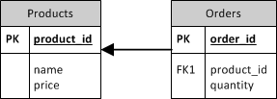
DROP TABLE with CASCADE
Tables: Products, Orders (references Products)
DROP TABLE products;
NOTICE: constraint orders_product_id_fkey on table orders depends on table products
ERROR: cannot drop table products because other objects depend on it
HINT: Use DROP ... CASCADE to drop the dependent objects too.

Slide 44
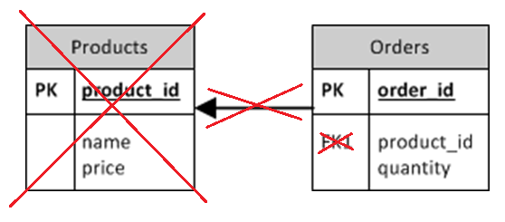
DROP TABLE with CASCADE
DROP TABLE products CASCADE;
In this case the command doesn’t delete the Orders table, only Foreign Key constraint.
RESTRICT keyword instead of CASCADE determines the default behavior: prevents removal of objects from which other objects depend on.

Slide 45
DROP TABLE full syntax
Full syntax of DROP TABLE command:
DROP TABLE [ IF EXISTS ] table_name [, ...] [ CASCADE | RESTRICT ]
IF EXISTS Do not throw an error if the table does not exist. A notice is issued in this case.

Slide 46
Books
Connolly, Thomas M. Database Systems: A Practical Approach to Design, Implementation, and Management / Thomas M. Connolly, Carolyn E. Begg.- United States of America: Pearson Education
Garcia-Molina, H. Database system: The Complete Book / Hector Garcia-Molina.- United States of America: Pearson Prentice Hall
Sharma, N. Database Fundamentals: A book for the community by the community / Neeraj Sharma, Liviu Perniu.- Canada
www.postgresql.org/docs/manuals/

